Slide 1
How to Delegate Computations:
The Power of No-Signaling Proofs
Ran Raz
(Weizmann Institute & IAS)
Joint work with:
Yael Tauman Kalai
Ron Rothblum

Slide 2
Delegation of Computation

Slide 3




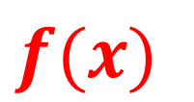
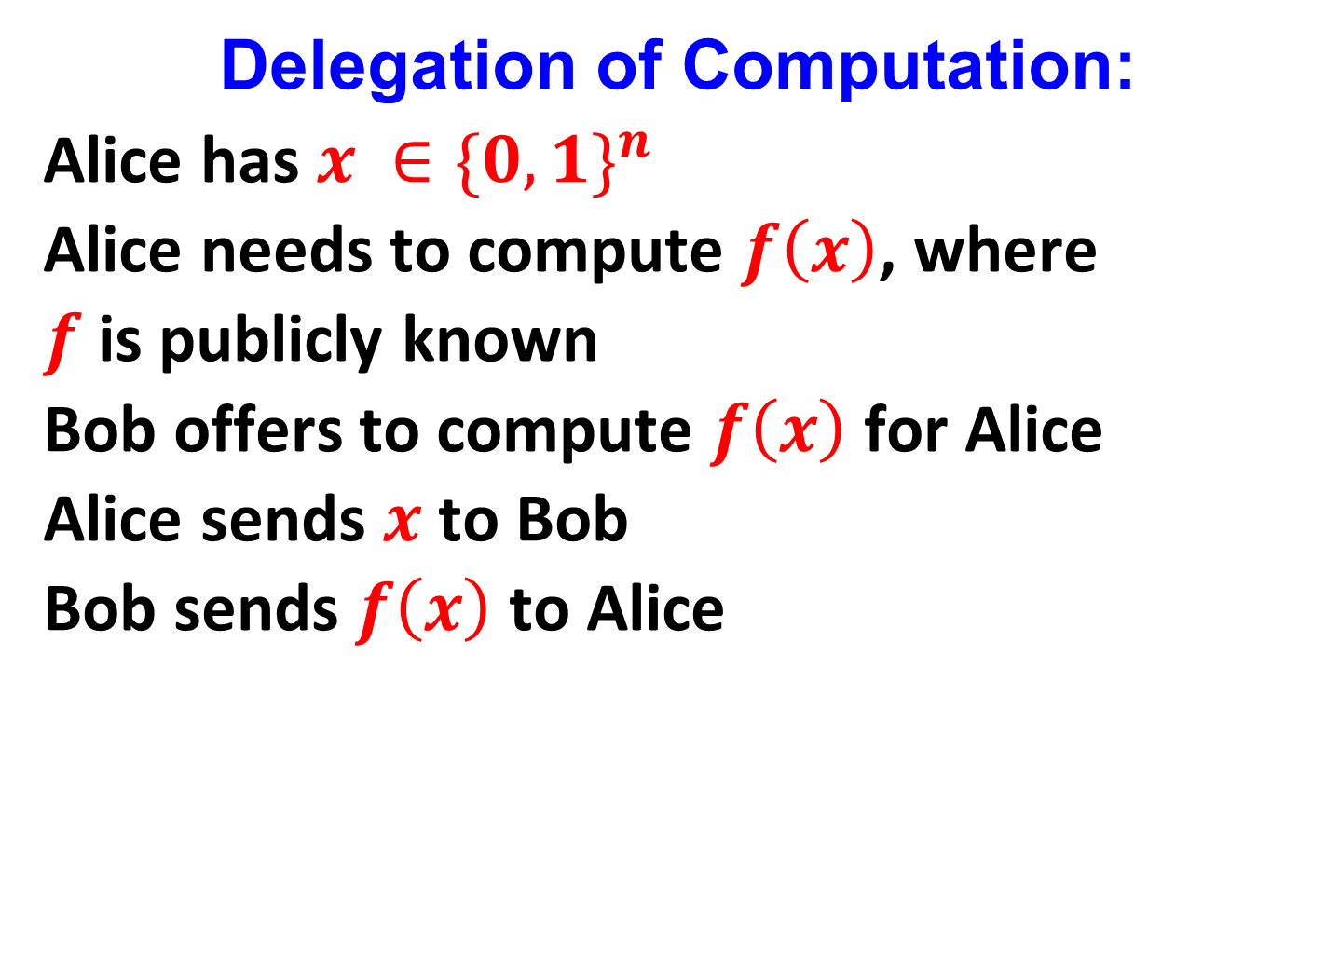

Delegation of Computation:
Alice has $x ∈{\{0,1\}}^{n}$
Alice needs to compute $f\left(x\right)$, where
$f$ is publicly known
Bob offers to compute $f\left(x\right)$ for Alice
Alice sends $x$ to Bob
Bob sends $f\left(x\right)$ to Alice
$$x$$
$$f(x)$$

Slide 4
Delegation of Computation:
But what if Alice doesn’t trust Bob?
Can Bob convince Alice that the computation
was done correctly, assuming that Alice
doesn’t have the computational power to
perform the computation by herself?

Slide 5

Meanwhile on Mars:

Slide 6


The Amazing Martian Engineering:

Slide 7


The Amazing Martian Engineers:

Slide 8


The Amazing Martian Engineers:

Slide 9

The Amazing Martian Engineers:
Martian Institute for Technology (MIT):
The EXPTIME machine!

Slide 10
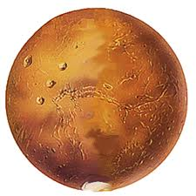

Delegating Computation to the Martians:
We want the Martians to perform a computation
Can they convince us that the computation was done correctly, assuming that we don’t have the computational power to perform the computation ourselves, and that we don’t trust Martians?

Slide 11
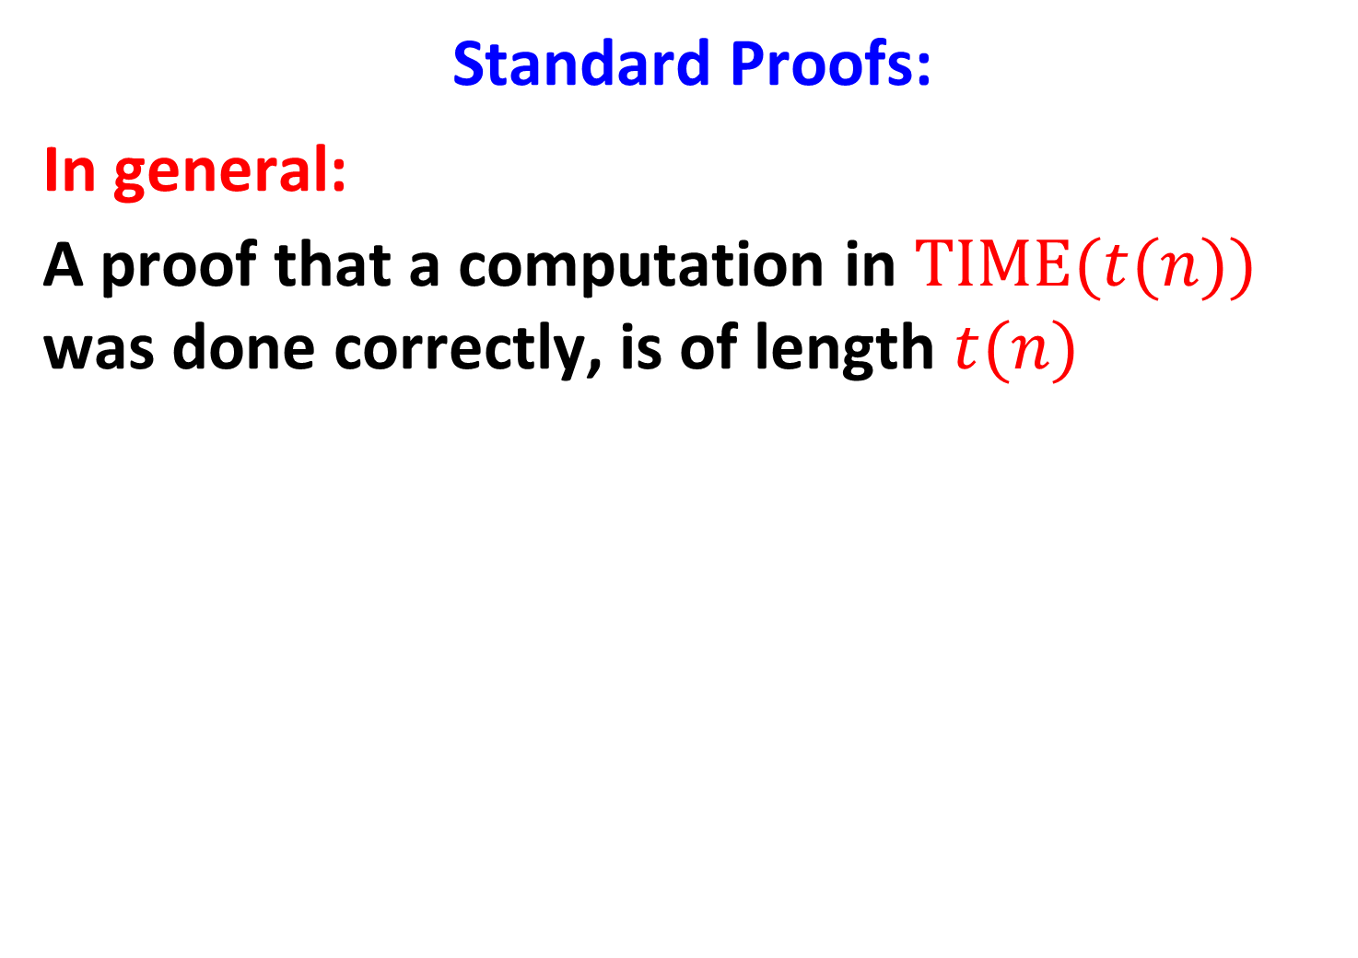
Standard Proofs:
In general:
A proof that a computation in $TIME(t(n))$ was done correctly, is of length $t(n)$

Slide 12


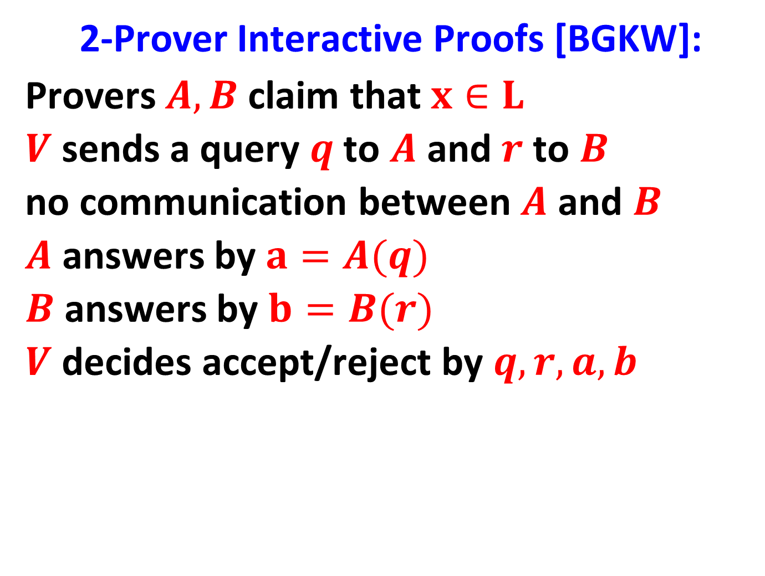





2-Prover Interactive Proofs [BGKW]:
Provers $A,B$ claim that $x∈L$
$V$ sends a query $q$ to $A$ and $r$ to $B$
no communication between $A$ and $B$
$A$ answers by $a=A(q)$
$B$ answers by $b=B(r)$
$V$ decides accept/reject by $q,r,a,b$
$$A$$
$$B$$
$$a$$
$$q$$
$$r$$
$$b$$

Slide 13
2-Prover Interactive Proofs [BGKW]:
Provers $A,B$ claim that $x∈L$
$V$ sends a query $q$ to $A$ and $r$ to $B$
no communication between $A$ and $B$
$A$ answers by $a=A(q)$
$B$ answers by $b=B(r)$
$V$ decides accept/reject by $q,r,a,b$

Slide 14
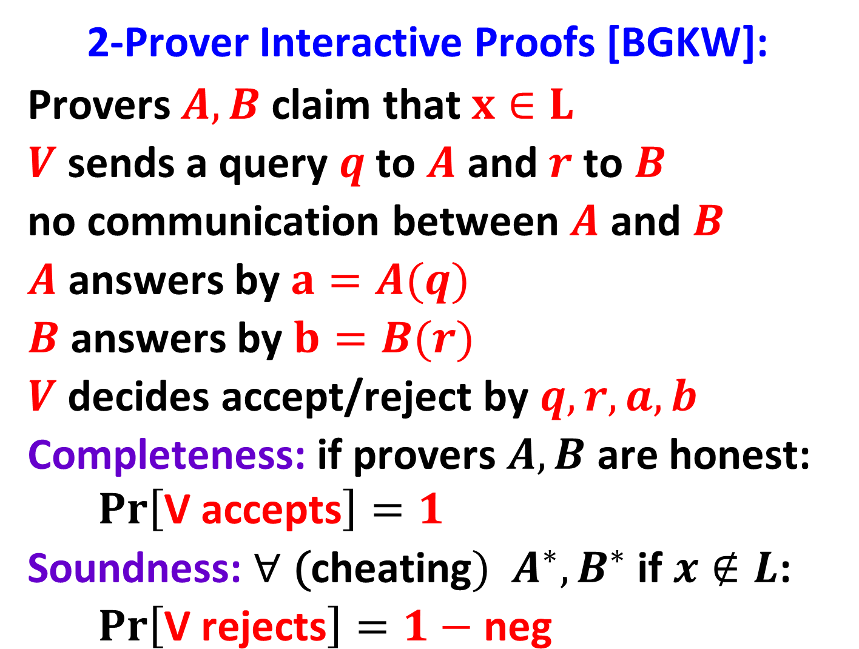
2-Prover Interactive Proofs [BGKW]:
Provers $A,B$ claim that $x∈L$
$V$ sends a query $q$ to $A$ and $r$ to $B$
no communication between $A$ and $B$
$A$ answers by $a=A(q)$
$B$ answers by $b=B(r)$
$V$ decides accept/reject by $q,r,a,b$
Completeness: if provers $A,B$ are honest:
$$Pr\left[\text{V} \text{accepts}\right]=1$$
Soundness: $∀\text{ (}\text{cheating}) A^{∗},B^{∗}$ if$x∉L$:
$$Pr\left[\text{V} \text{rejects}\right]=1−\text{neg}$$

Slide 15

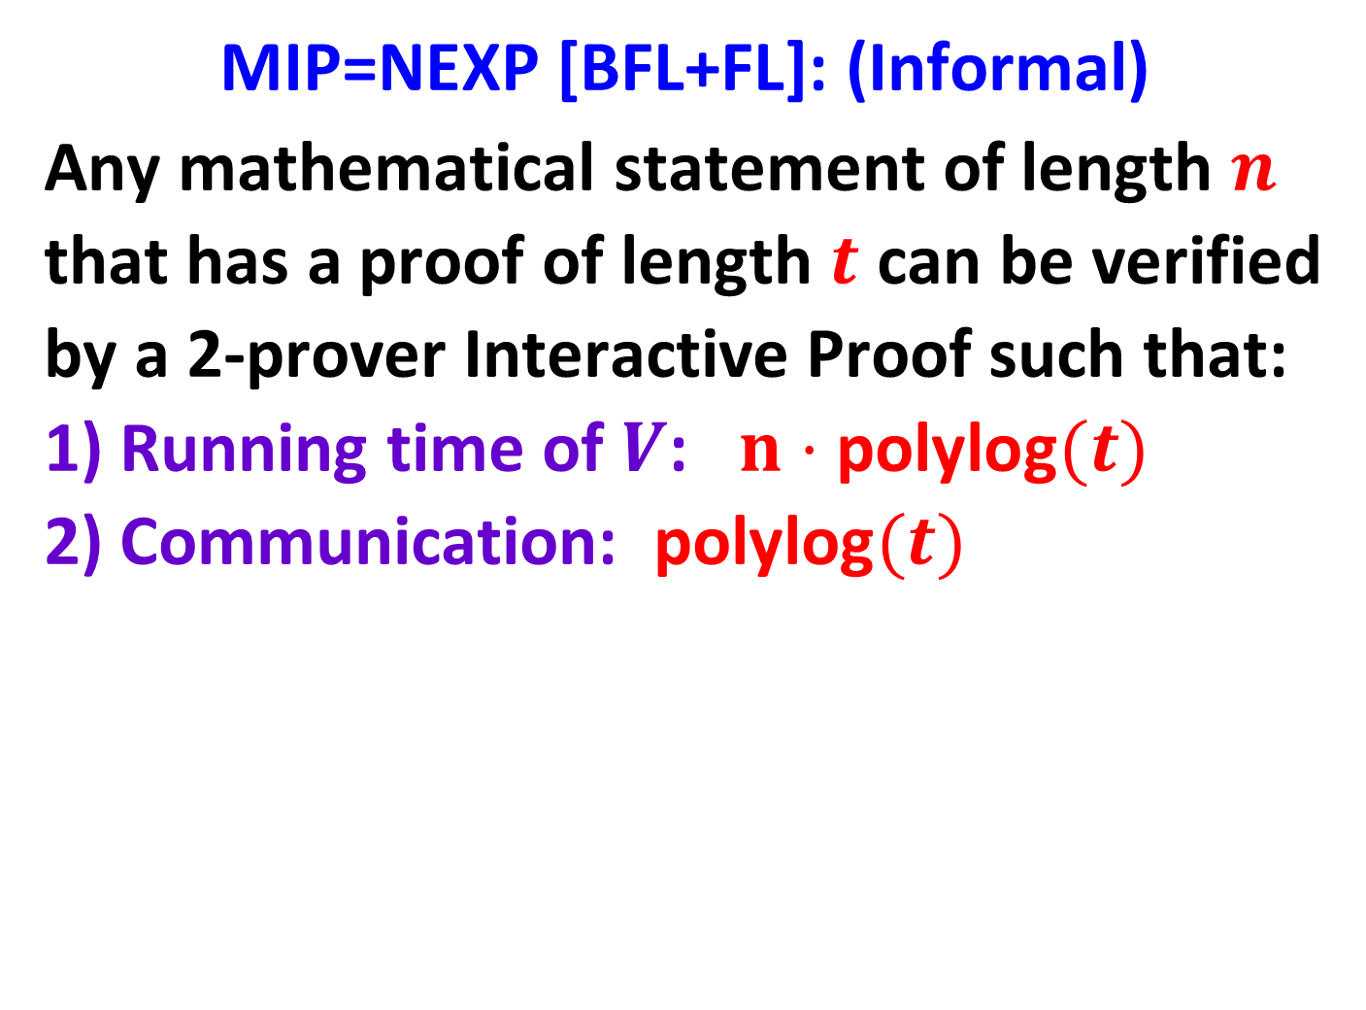





MIP=NEXP [BFL+FL]: (Informal)
Any mathematical statement of length $n$
that has a proof of length $t$ can be verified
by a 2-prover Interactive Proof such that:
1) Running time of $V$: $n⋅\text{polylog}(t)$
2) Communication: $\text{pol}\text{ylog}(t)$
$$A$$
$$B$$
$$q$$
$$r$$
$$a$$
$$b$$

Slide 16
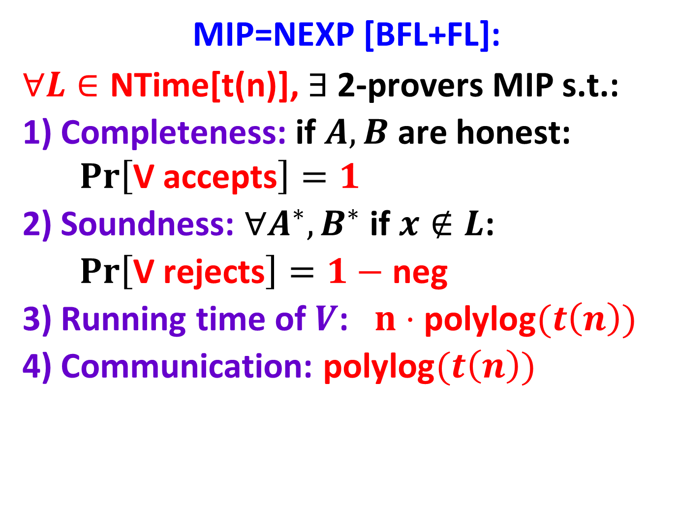
MIP=NEXP [BFL+FL]:
$∀L∈\text{NTime}\text{[}\text{t}\text{(}\text{n}\text{)}\text{]}$, $∃$2-provers MIP s.t.:
1) Completeness: if $A,B$ are honest:
$$Pr\left[\text{V} \text{accepts}\right]=1$$
2) Soundness: $∀A^{∗},B^{∗}$ if$x∉L$:
$$Pr\left[\text{V} \text{rejects}\right]=1−\text{neg}$$
3) Running time of $V$: $n⋅\text{polylog}(t\left(n\right))$
4) Communication: $\text{pol}\text{ylog}(t\left(n\right))$
$$A$$
$$B$$
$$q$$
$$r$$
$$a$$
$$b$$

Slide 17


Delegating Computation to the Martians:
We want the Martians to convince us that a computation was performed correctly
$$A$$
$$B$$
$$q$$
$$r$$
$$a$$
$$b$$

Slide 18
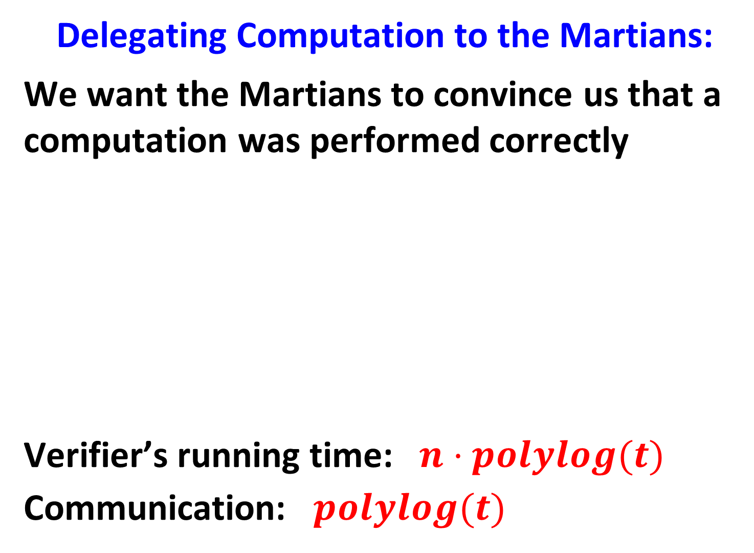
Delegating Computation to the Martians:
We want the Martians to convince us that a computation was performed correctly
Verifier’s running time: $n⋅polylog(t)$
Communication: $polylog(t)$
$$A$$
$$B$$
$$q$$
$$r$$
$$a$$
$$b$$

Slide 19
Delegating Computation to the Martians:
We want the Martians to convince us that a computation was performed correctly
$$A$$
$$B$$
$$q$$
$$r$$
$$a$$
$$b$$

Slide 20
Delegating Computation to the Martians:
We want the Martians to convince us that a computation was performed correctly
no communication between the provers:
can be guaranteed by special relativity
$$A$$
$$B$$
$$q$$
$$r$$
$$a$$
$$b$$

Slide 21
QIP 2004: [CHTW]
Didn’t we forget something???
$$A$$
$$B$$
$$q$$
$$r$$
$$a$$
$$b$$

Slide 22
QIP 2004: [CHTW]
Didn’t we forget something???
What if the provers share entangled quantum states??? Maybe they can cheat!!!
$$A$$
$$B$$
$$q$$
$$r$$
$$a$$
$$b$$

Slide 23

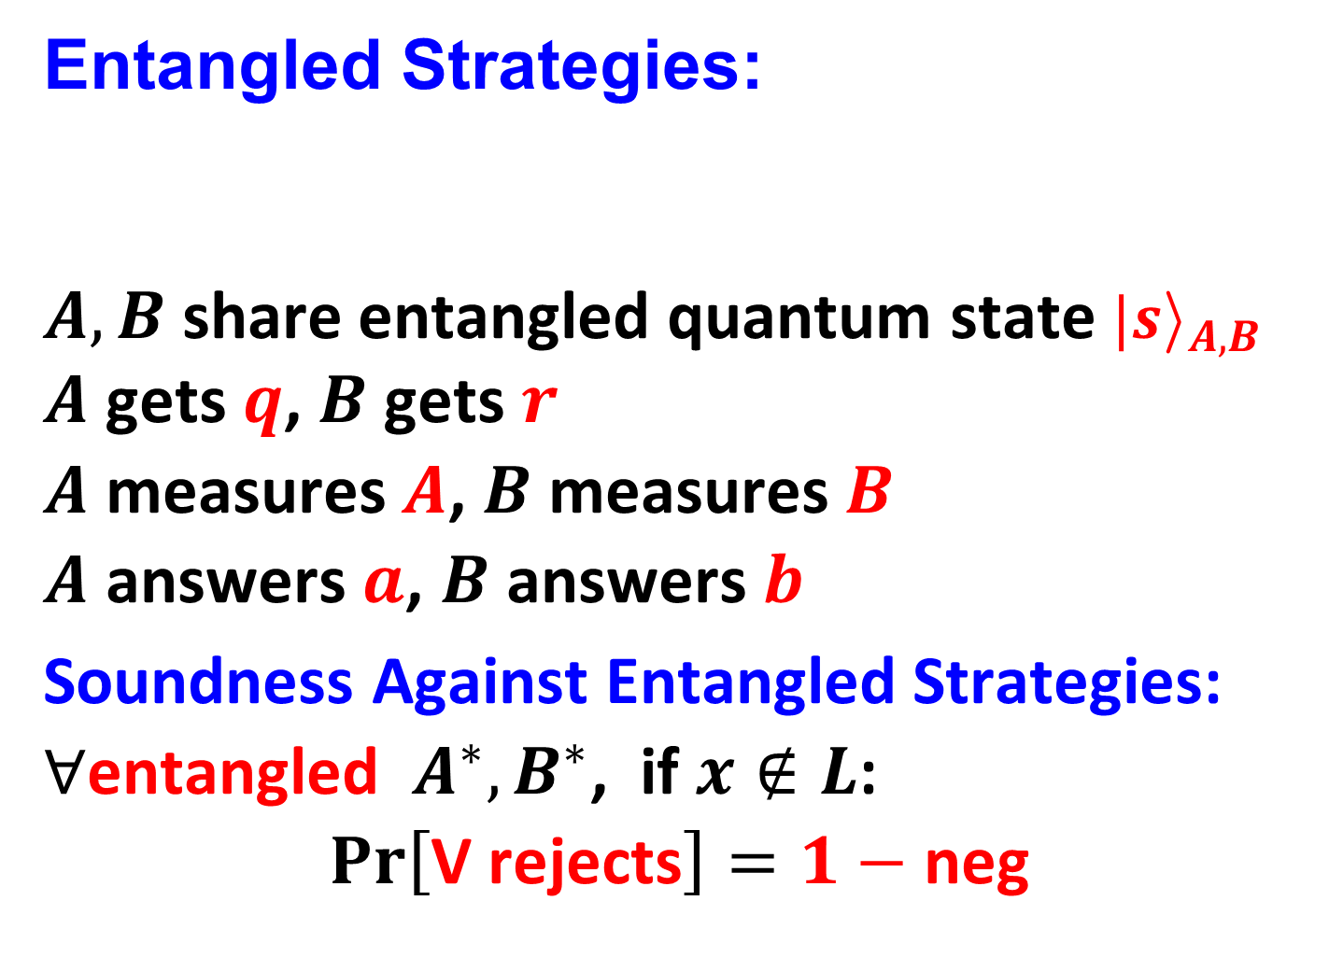

$$B$$
Entangled Strategies:
$A,B$ share entangled quantum state ${|s\text{i}}_{A,B}$
$A$ gets $q$, $B$ gets $r$
$A$ measures $A$, $B$ measures $B$
$A$ answers $a$, $B$ answers $b$
Soundness Against Entangled Strategies:
$∀\text{entangled} A^{∗},B^{∗}$, if$x∉L$:
$$Pr\left[\text{V} \text{rejects}\right]=1−\text{neg}$$
$$A$$
$$q$$
$$r$$
$$a$$
$$b$$

Slide 24
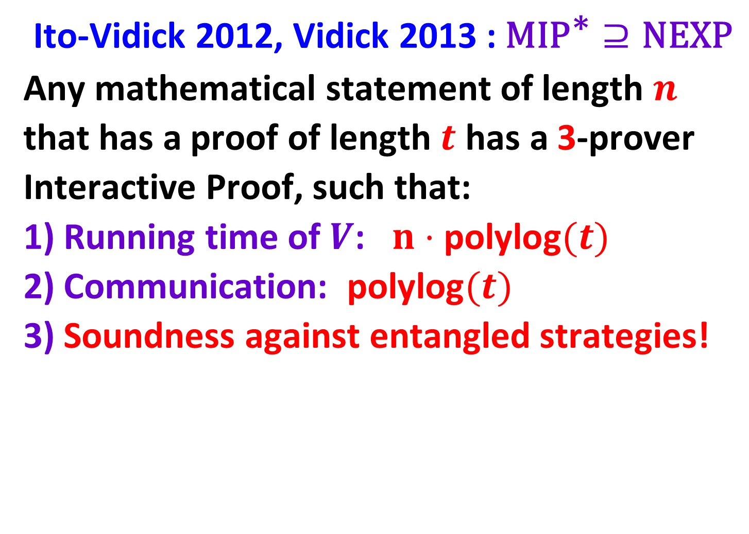
Ito-Vidick 2012, Vidick 2013 : $\text{MI}{\text{P}}^{\text{∗}}⊇\text{NEXP}$
Any mathematical statement of length $n$
that has a proof of length $t$ has a 3-prover
Interactive Proof, such that:
1) Running time of $V$: $n⋅\text{polylog}(t)$
2) Communication: $\text{polylog}(t)$
3) Soundness against entangled strategies!

Slide 25
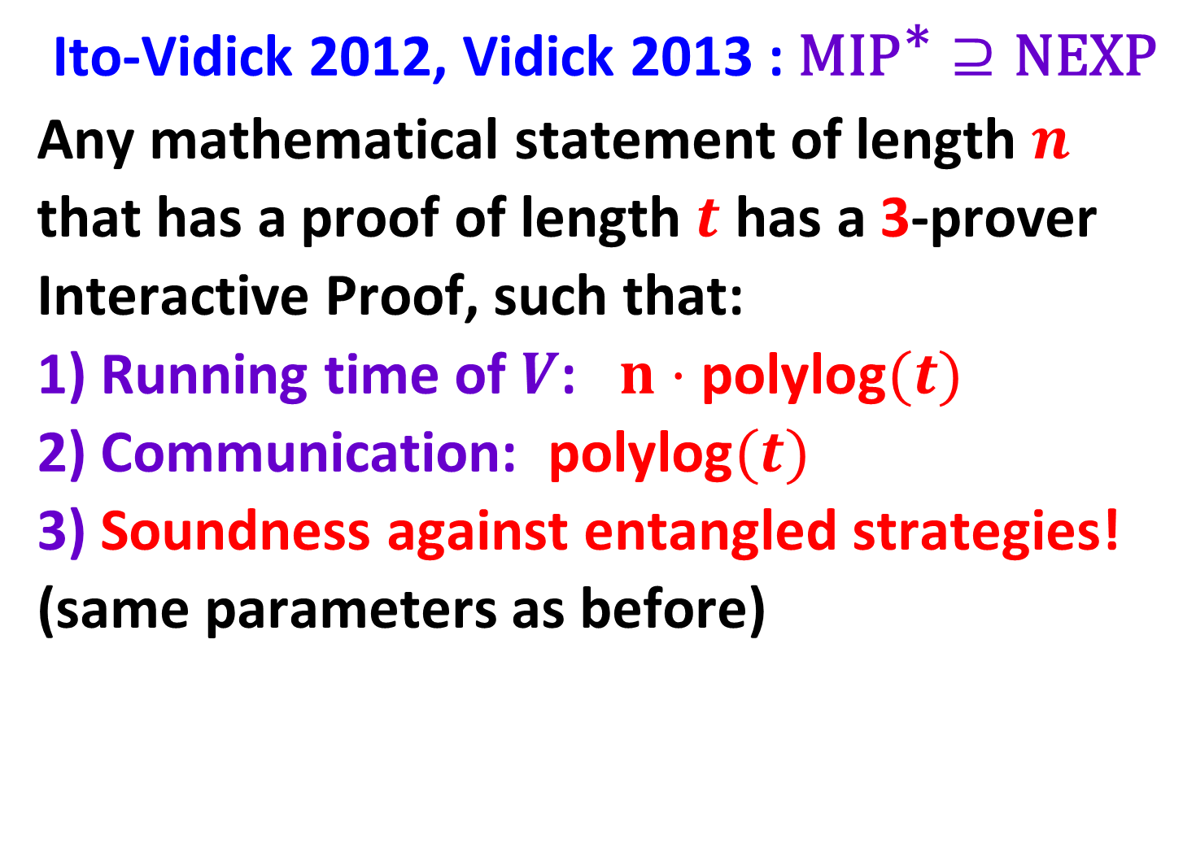
Ito-Vidick 2012, Vidick 2013 : $\text{MI}{\text{P}}^{\text{∗}}⊇\text{NEXP}$
Any mathematical statement of length $n$
that has a proof of length $t$ has a 3-prover
Interactive Proof, such that:
1) Running time of $V$: $n⋅\text{polylog}(t)$
2) Communication: $\text{polylog}(t)$
3) Soundness against entangled strategies!
(same parameters as before)

Slide 26
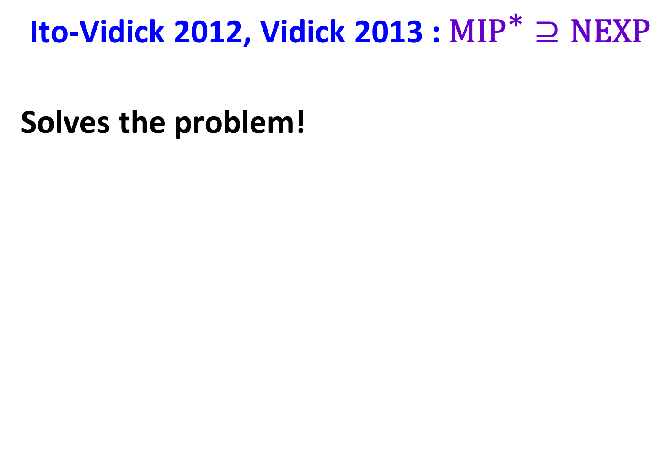
Ito-Vidick 2012, Vidick 2013 : $\text{MI}{\text{P}}^{\text{∗}}⊇\text{NEXP}$
Solves the problem!

Slide 27

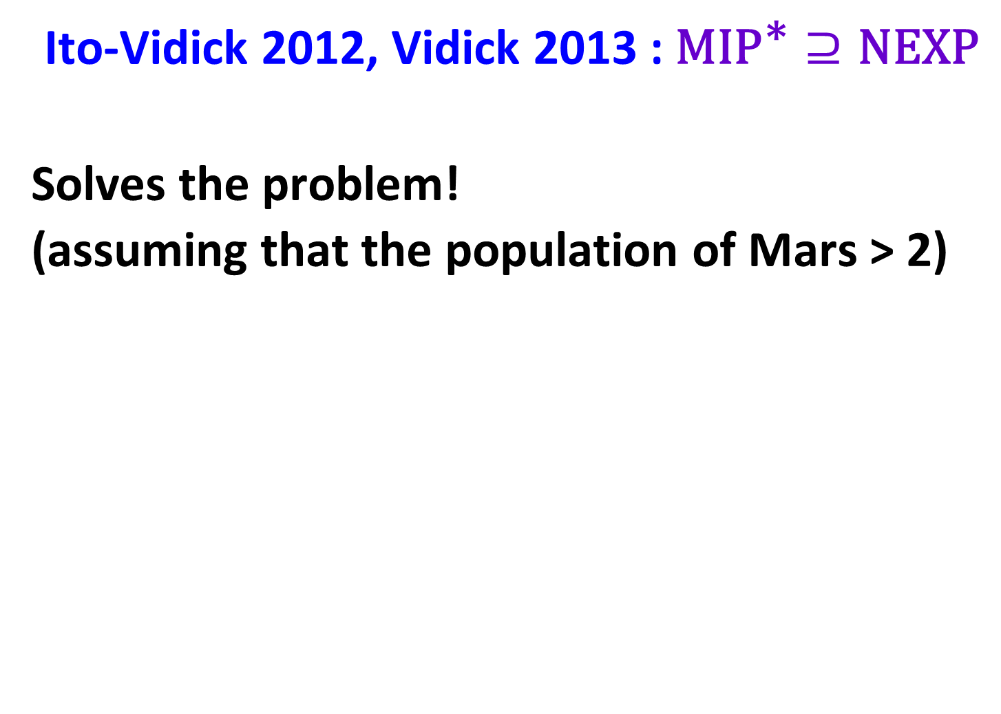
Ito-Vidick 2012, Vidick 2013 : $\text{MI}{\text{P}}^{\text{∗}}⊇\text{NEXP}$
Solves the problem!
(assuming that the population of Mars > 2)

Slide 28
No-Signaling Strategies

Slide 29
No-Signaling Strategies
More general than entangled strategies:
All strategies that cannot be used for passing information between the provers

Slide 30
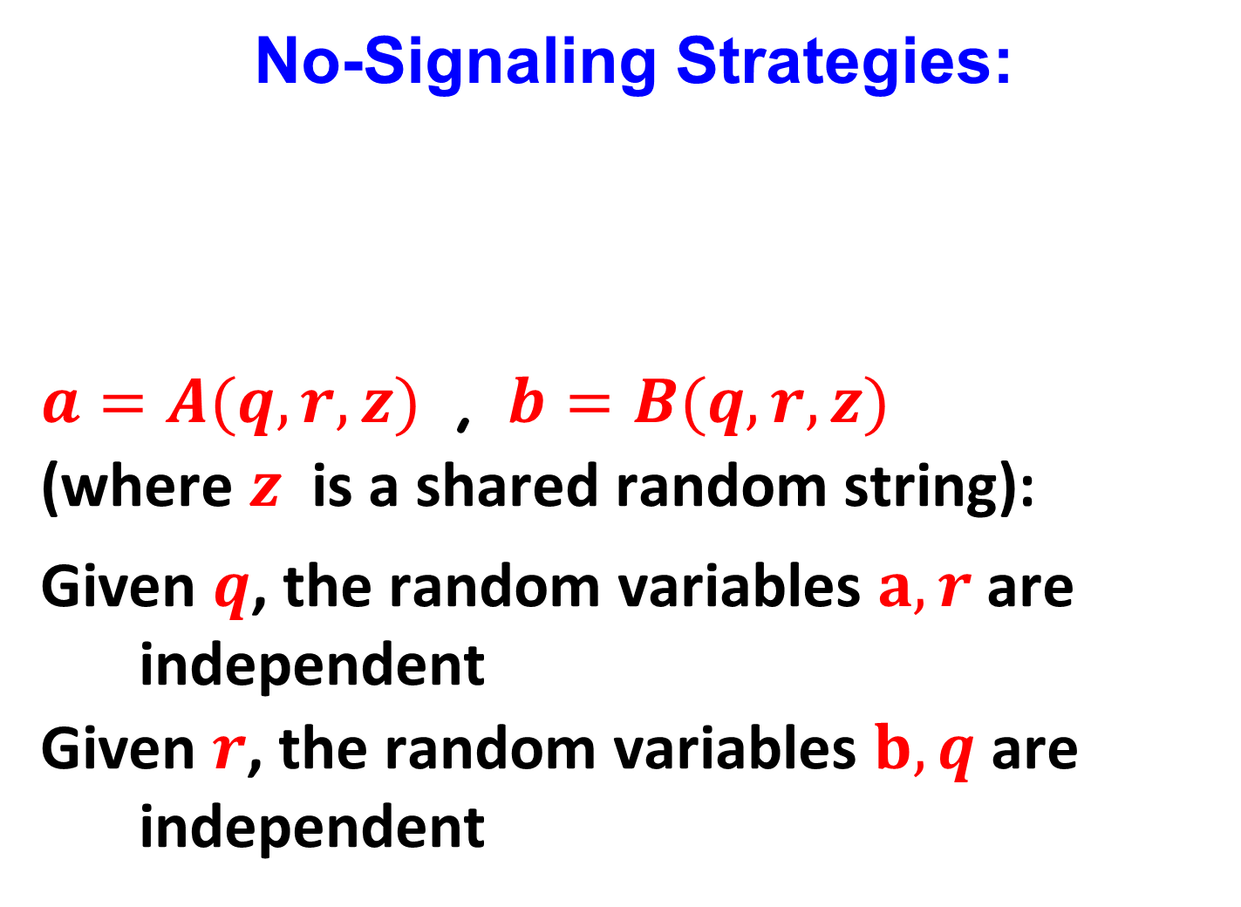
No-Signaling Strategies:
$a=A(q,r,z)$ , $b=B(q,r,z)$
(where $z$ is a shared random string):
Given $q$, the random variables $a,r$ are independent
Given $r$, the random variables $b,q$ are independent
$$A$$
$$B$$
$$q$$
$$r$$
$$a$$
$$b$$

Slide 31
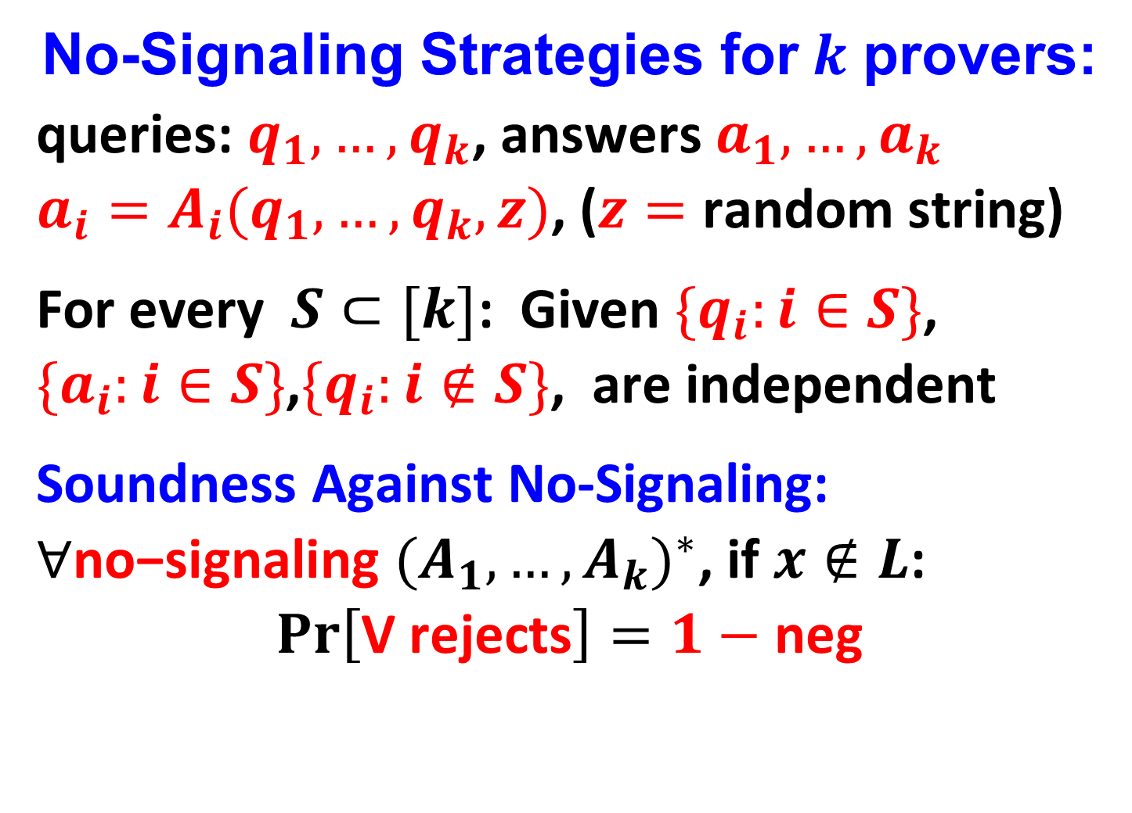
No-Signaling Strategies for$k$ provers:
queries: $q_{1},…,q_{k}$, answers $a_{1},…,a_{k}$
$a_{i}=A_{i}(q_{1},…,q_{k},z)$, ($z=$ random string)
For every $S⊂[k]$: Given ${\{q}_{i}:i∈S\}$,
${\{a}_{i}:i∈S\}$,${\{q}_{i}:i∉S\}$, are independent
Soundness Against No-Signaling:
$∀\text{no}\text{−}\text{signaling} {(A_{1},…,A_{k})}^{∗}$, if$x∉L$:
$$Pr\left[\text{V} \text{rejects}\right]=1−\text{neg}$$

Slide 32

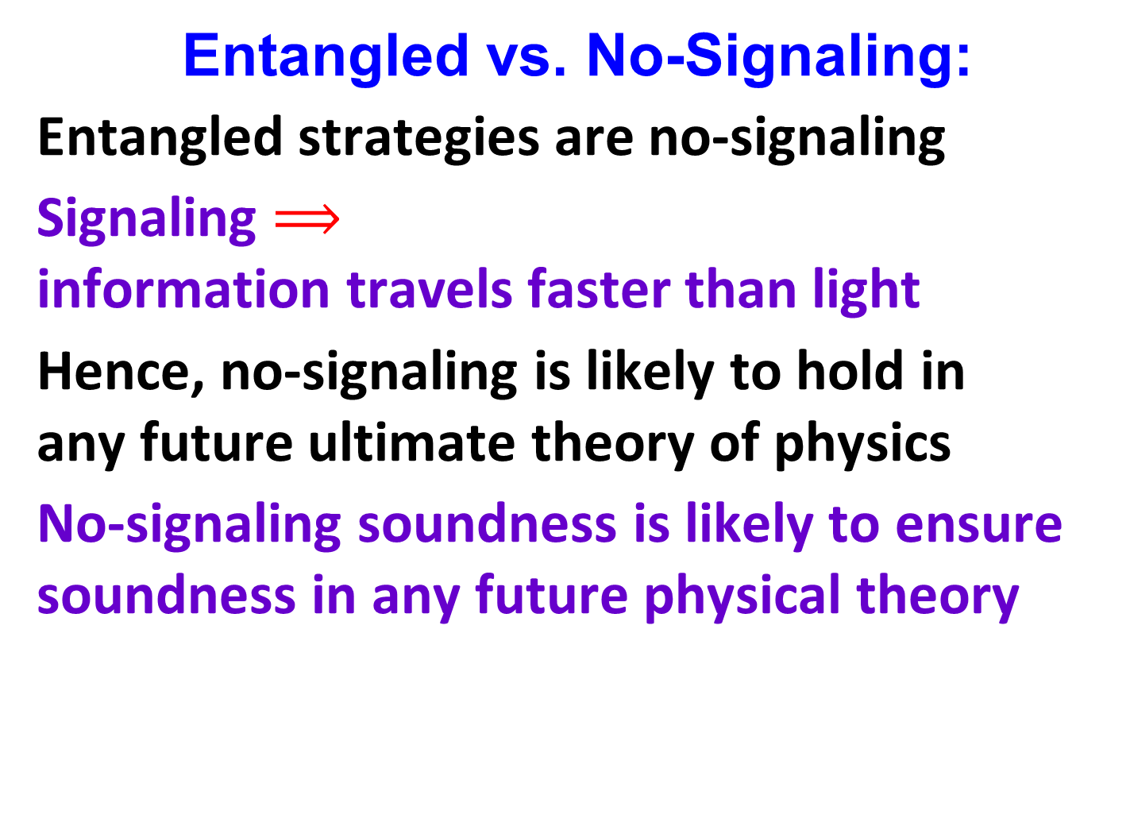

Entangled vs. No-Signaling:
Entangled strategies are no-signaling
Signaling $⟹$
information travels faster than light
Hence, no-signaling is likely to hold in
any future ultimate theory of physics
No-signaling soundness is likely to ensure
soundness in any future physical theory
$$A$$
$$B$$
$$q$$
$$r$$
$$a$$
$$b$$

Slide 33
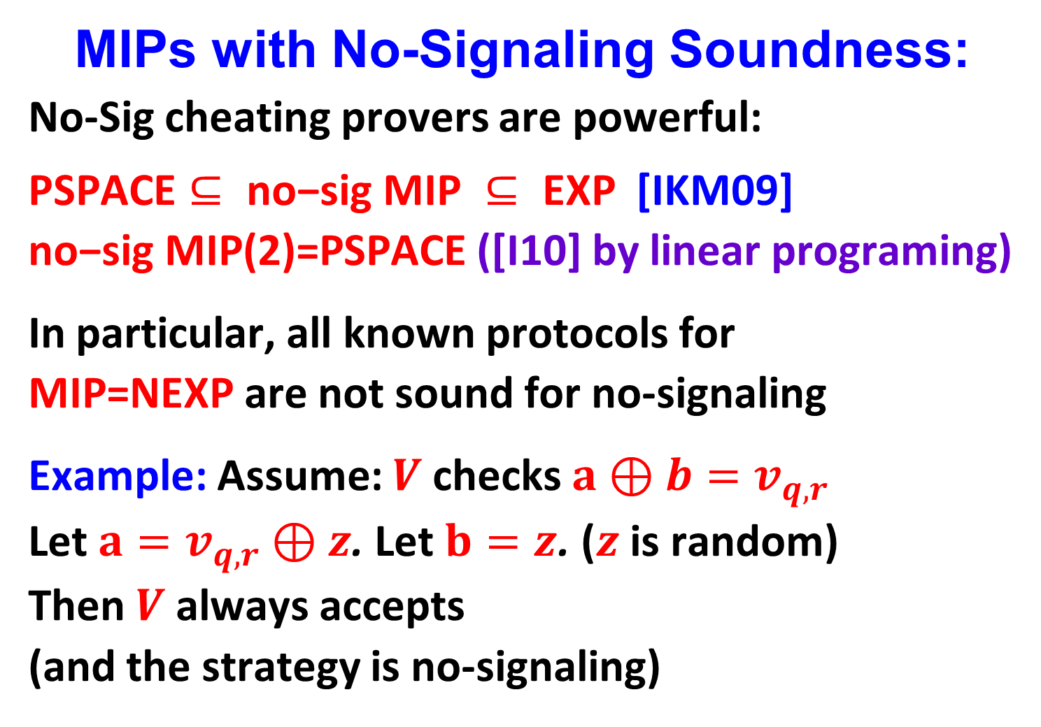
MIPs with No-Signaling Soundness:
No-Sig cheating provers are powerful:
$\text{PSPACE}⊆ \text{no}\text{−}\text{sig} \text{MIP} ⊆ \text{EXP}$ [IKM09]
$\text{no}\text{−}\text{sig} \text{M}\text{IP}\text{(}\text{2}\text{)=}\text{PSPACE}$ ([I10] by linear programing)
In particular, all known protocols for
$\text{MIP}\text{=}\text{NEXP}$are not sound for no-signaling
Example: Assume: $V$ checks $a⊕b=v_{q,r}$
Let $a=v_{q,r}⊕z$. Let $b=z$. ($z$ is random)
Then $V$always accepts
(and the strategy is no-signaling)

Slide 34
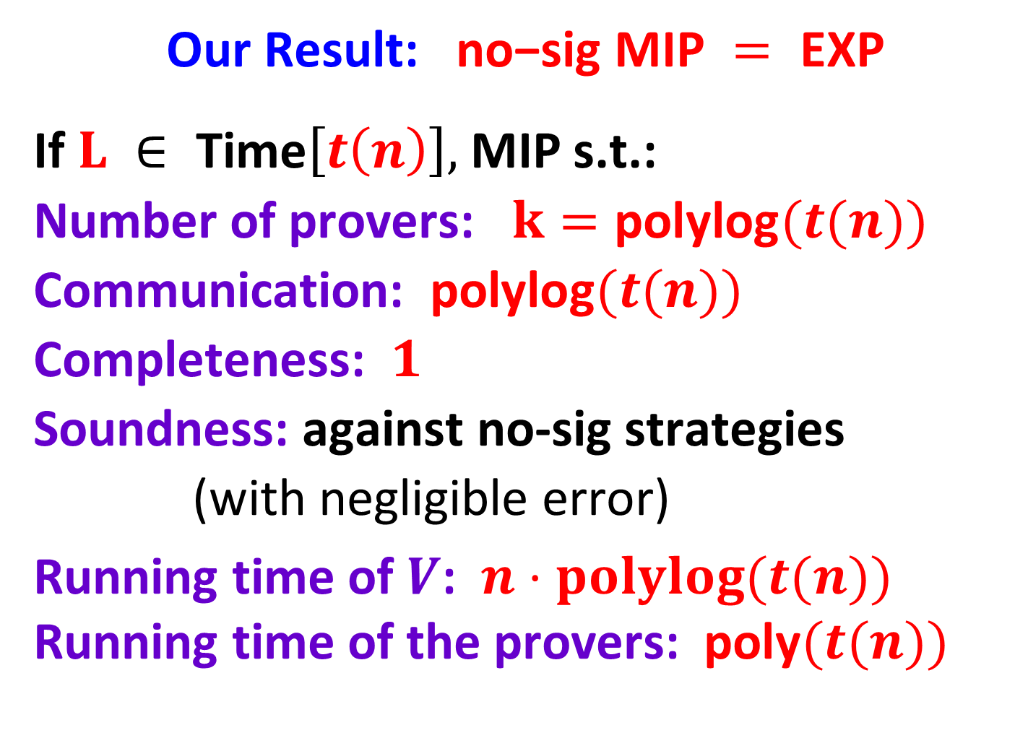
Our Result: $\text{no}\text{−}\text{sig} \text{MIP} = \text{EXP}$
If $L ∈ \text{Time}\left[t\left(n\right)\right],$MIP s.t.:
Number of provers: $k=\text{poly}\text{log}(t(n))$
Communication: $\text{polylog}(t(n))$
Completeness: $1$
Soundness: against no-sig strategies
(with negligible error)
Running time of $V$: $n⋅polylog(t(n))$
Running time of the provers: $\text{poly}(t(n))$

Slide 35


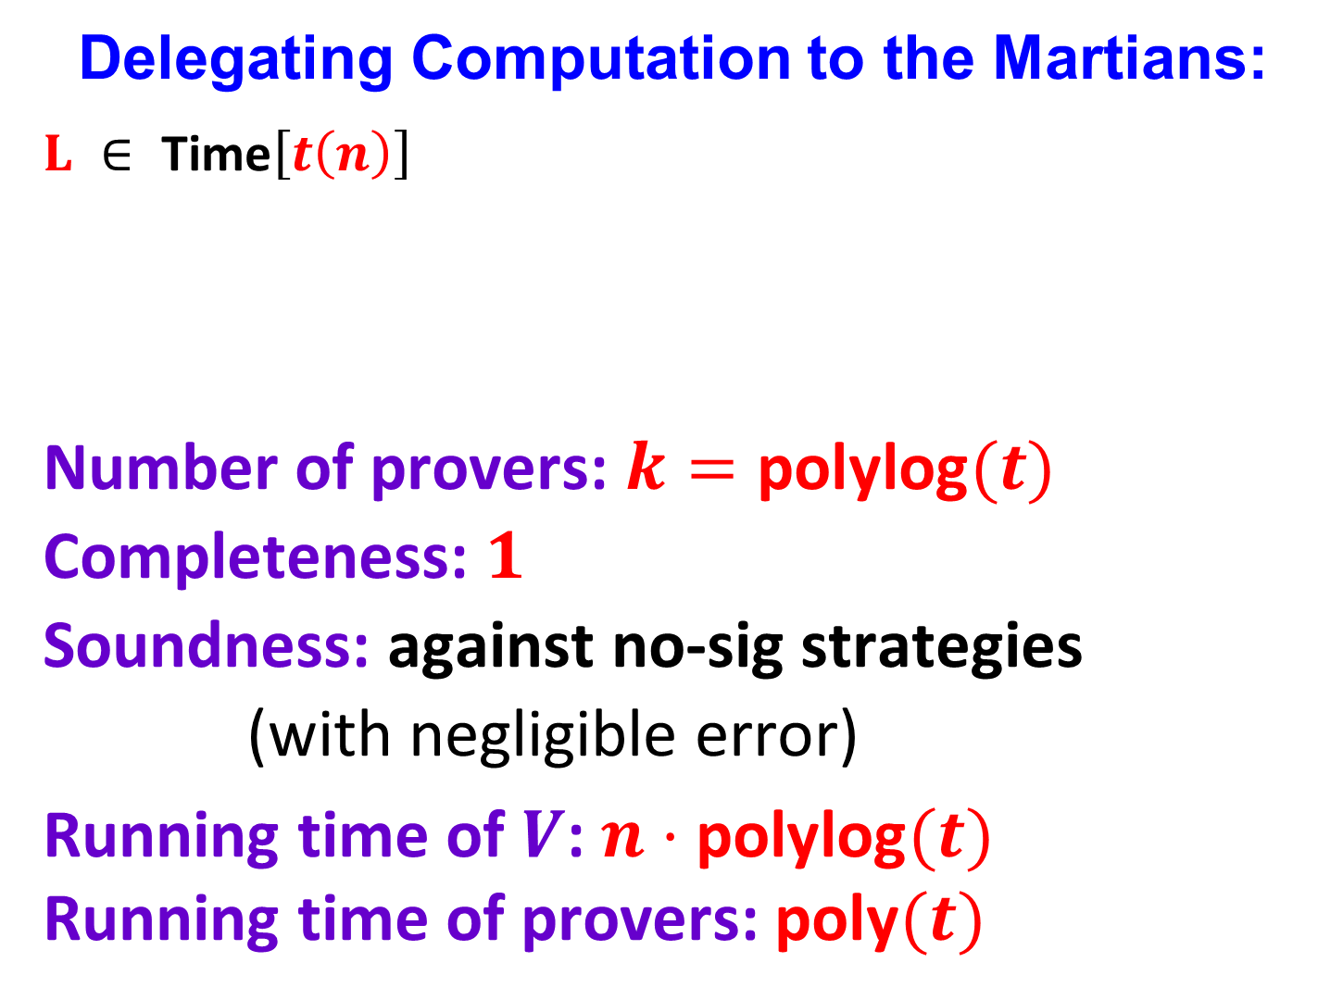






Delegating Computation to the Martians:
$L ∈ \text{Time}\left[t\left(n\right)\right]$
Number of provers: $k=\text{polylog}(t)$
Completeness: $1$
Soundness: against no-sig strategies
(with negligible error)
Running time of $V$: $n⋅\text{polylog}(t)$
Running time of provers: $\text{poly}(t)$
$$P_{1}$$
$$P_{2}……$$
$$P_{k}$$
$$a_{1}$$
$$q_{1}..$$
$$q_{k}$$
$$a_{k}$$

Slide 36

Meanwhile on Earth

Slide 37
Delegation of Computation:
$$x$$
$$f(x)$$

Slide 38
Delegation of Computation:
Only one prover
$$x$$
$$f(x)$$

Slide 39
Delegation of Computation:
Only one prover
and we don’t trust it…
$$x$$
$$f(x)$$

Slide 40
The Approach of Aiello et al.

Slide 41


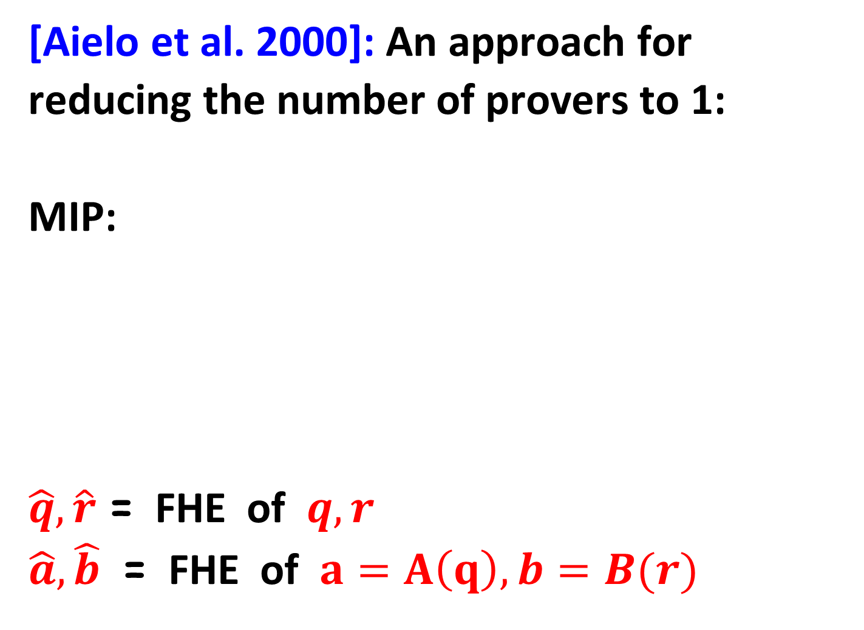


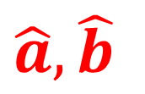



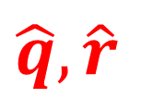

[Aielo et al. 2000]: An approach for
reducing the number of provers to 1:
MIP:
$\hat{q},\hat{r}$ = FHE of $q,r$
$\hat{a},\hat{b}$ = FHE of $a=A\left(q\right), b=B(r)$
$$A$$
$$B$$
$$a=A(q)$$
$$q$$
$$r$$
$$b=B(r)$$
$$\hat{q},\hat{r}$$
$$V$$
$$\hat{a},\hat{b}$$
$$P$$

Slide 42
We Show:
The approach works if the MIP has
no-signaling soundness

Slide 43
We Show:
The approach works if the MIP has
no-signaling soundness
Corollary:
In the cryptographic setting the number of
provers can be reduced to 1

Slide 44
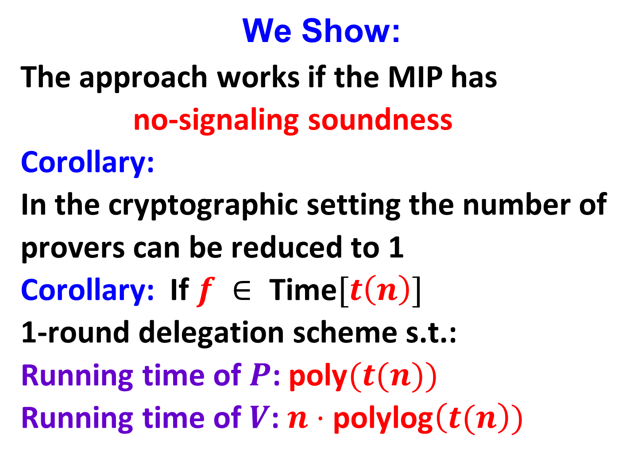
We Show:
The approach works if the MIP has
no-signaling soundness
Corollary:
In the cryptographic setting the number of
provers can be reduced to 1
Corollary: If $f ∈ \text{Time}[t\left(n\right)]$
1-round delegation scheme s.t.:
Running time of $P$: $\text{poly}(t(n))$
Running time of $V$: $n⋅\text{polylog}\left(t(n\right))$

Slide 45
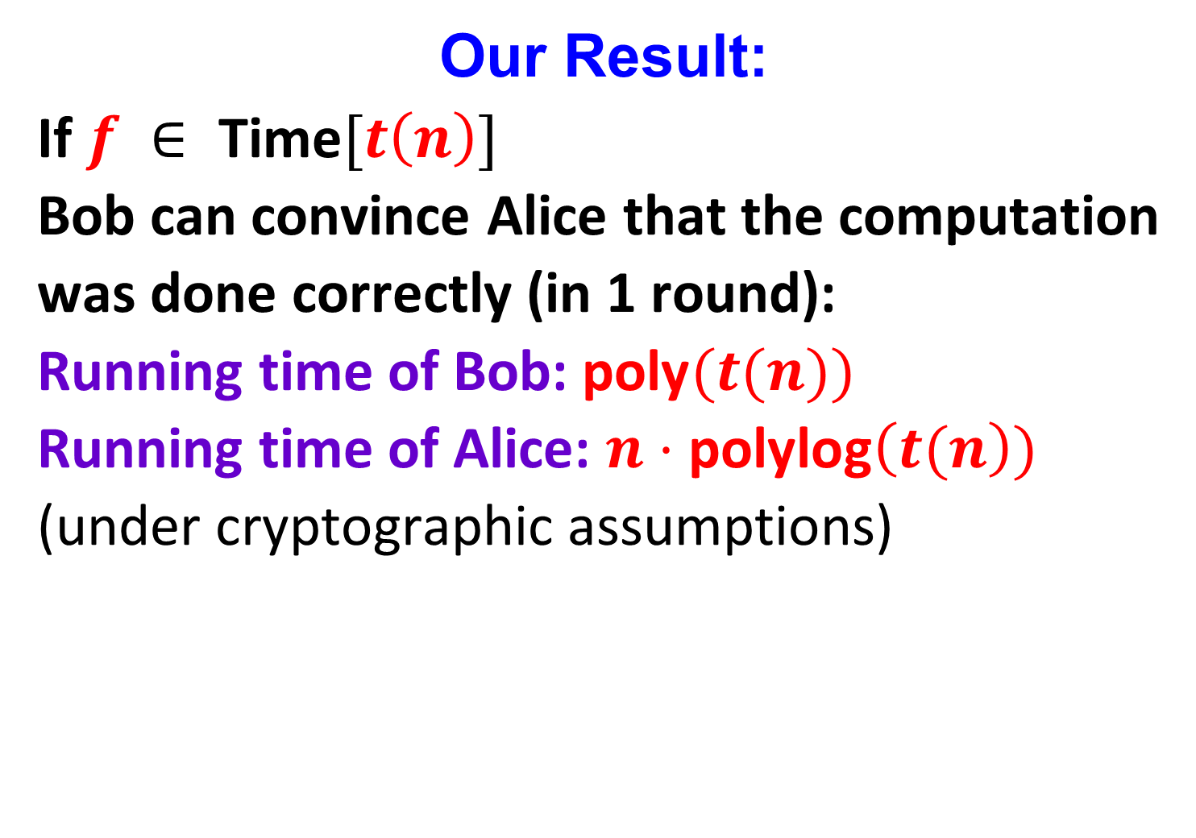
Our Result:
If $f ∈ \text{Time}[t\left(n\right)]$
Bob can convince Alice that the computation
was done correctly (in 1 round):
Running time of Bob: $\text{poly}(t(n))$
Running time of Alice: $n⋅\text{poly}\text{log}\left(t(n\right))$
(under cryptographic assumptions)

Slide 46

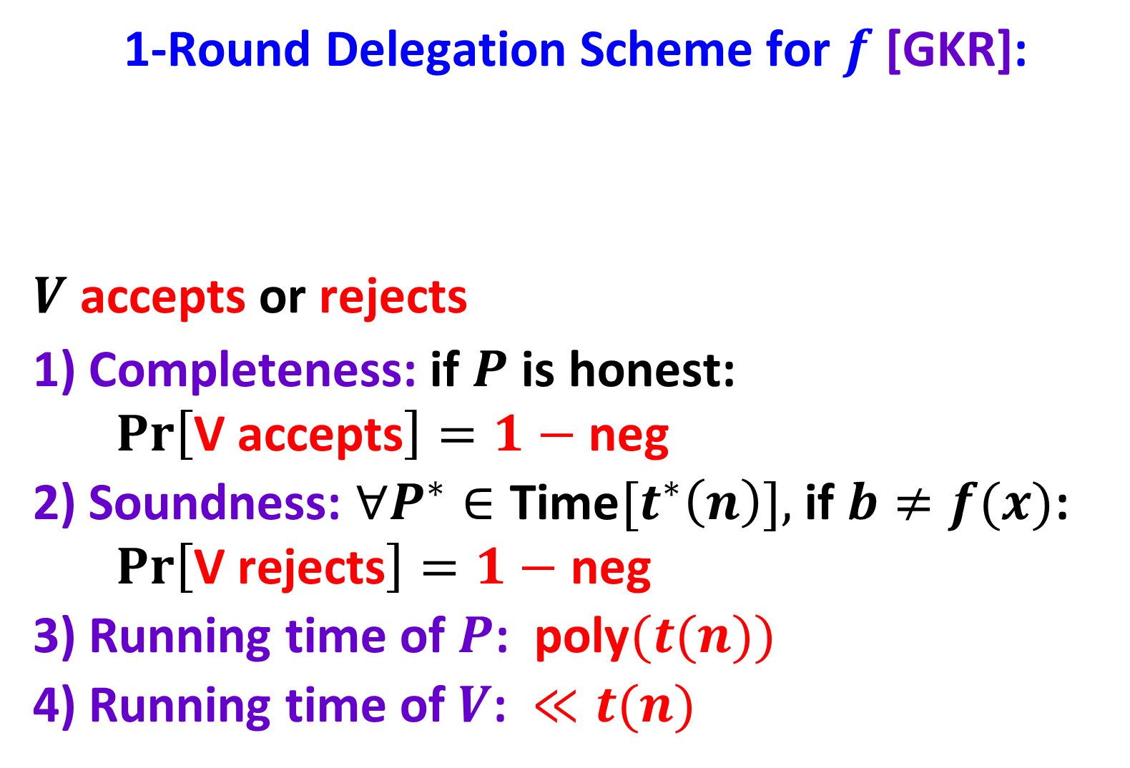
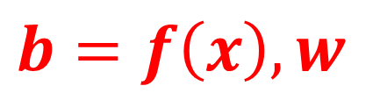
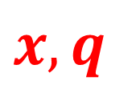
1-Round Delegation Scheme for $f$[GKR]:
$V \text{accepts}$ or $\text{rejects}$
1) Completeness: if $P$ is honest:
$$Pr\left[\text{V} \text{accepts}\right]=1−\text{neg}$$
2) Soundness: $∀P^{∗}∈\text{Time}[t^{∗}\left(n\right)],$ if$b≠f(x)$:
$$Pr\left[\text{V} \text{reject}\text{s}\right]=1−\text{neg}$$
3) Running time of $P$: $\text{poly}(t(n))$
4) Running time of $V$: $≪t(n)$
$$x,q$$
$$V$$
$$b=f\left(x\right),w$$
$$P$$
$$f ∈\text{Time}[t\left(n\right)]$$

Slide 47
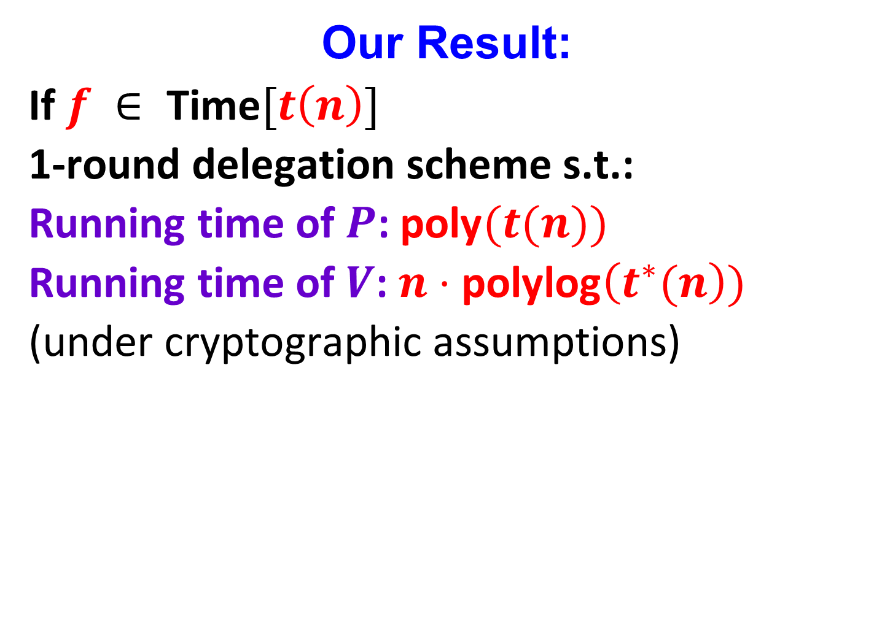
Our Result:
If $f ∈ \text{Time}[t\left(n\right)]$
1-round delegation scheme s.t.:
Running time of $P$: $\text{poly}(t(n))$
Running time of $V$: $n⋅\text{poly}\text{log}\left(t^{∗}(n\right))$
(under cryptographic assumptions)

Slide 48
Very Recent Application:
Quasi-P hardness of approximation of
Linear Programing with Preprocessing

Slide 49
Open Problem:
What is the power of no-signaling MIP with
a constant number of provers?
We know that it is between PSPACE and EXP

Slide 50
Thank You!

